Slide 1
NHERI GSC November General Meeting

Slide 2
Agenda
11:00-11:05 Welcome & Announcements
11:08-11:38 Dr. Tim Cockerill
11:40-11:58 Q & A
11:58-12:00 Wrap up

Slide 3
Welcome New Members
Juliana | Pereira |  | Jose | Capa Salinas
Kristina | Fillman |  | Rajendra | Gautam
Justin | Smith |  | Nicolas | Coello
Najiba | Rashid |  | Himadri Sen | Gupta
Aneika | Perez |  | Bijan | Sayyafzadeh
Diego | Valdivieso Cascante |  | Huanru | Zhu
*Reach out to Daniel Yahya and Jenny Russell to learn how to get involved!

Slide 4
Approve Amendments
#1
#2
#3
A Qualtrics survey will be sent out for you to vote on accepting or rejecting these ammendments.

Slide 5
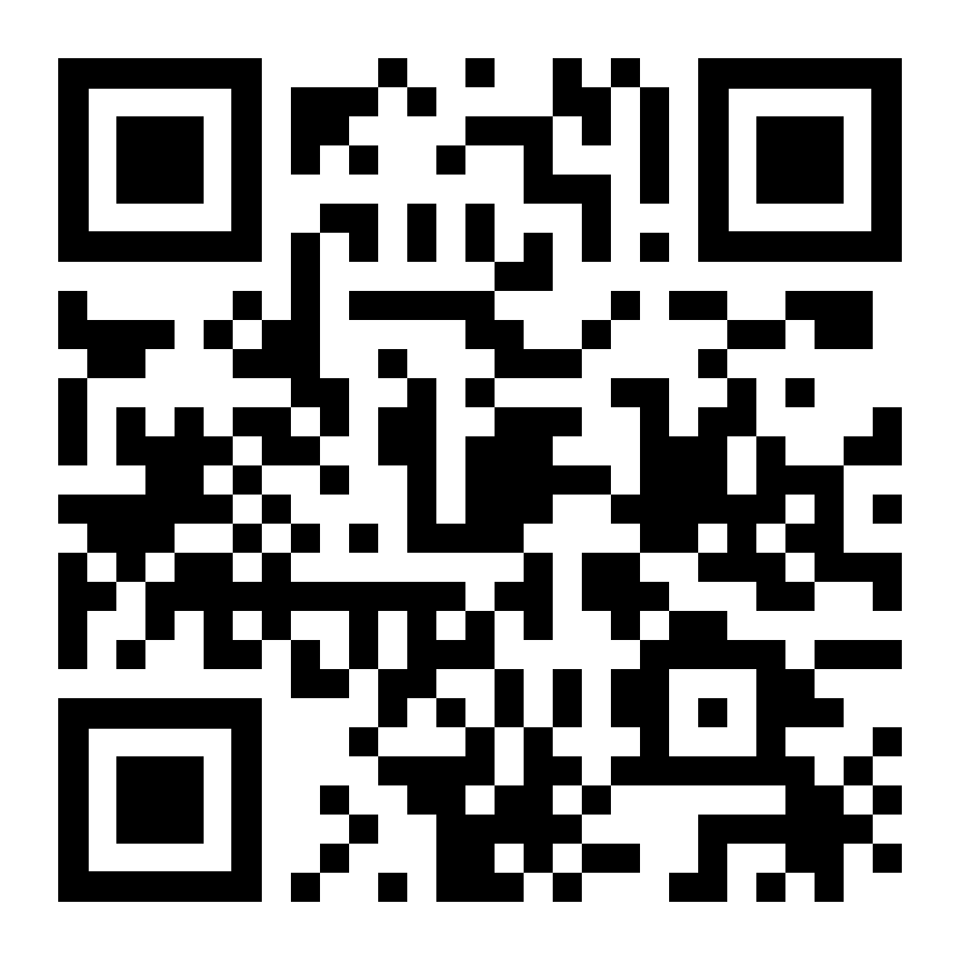
Leadership Opportunities
Nominations except until November 24, 2023 at 11:59pm CST for the following positions:
Vice Secretary
Vice Treasurer
Vice Chair of Technology & Communication
Must be a member in good standing who has attended at least two meetings in 2023.
https://bit.ly/2023NHERIGSC_FallCandidates

Slide 6
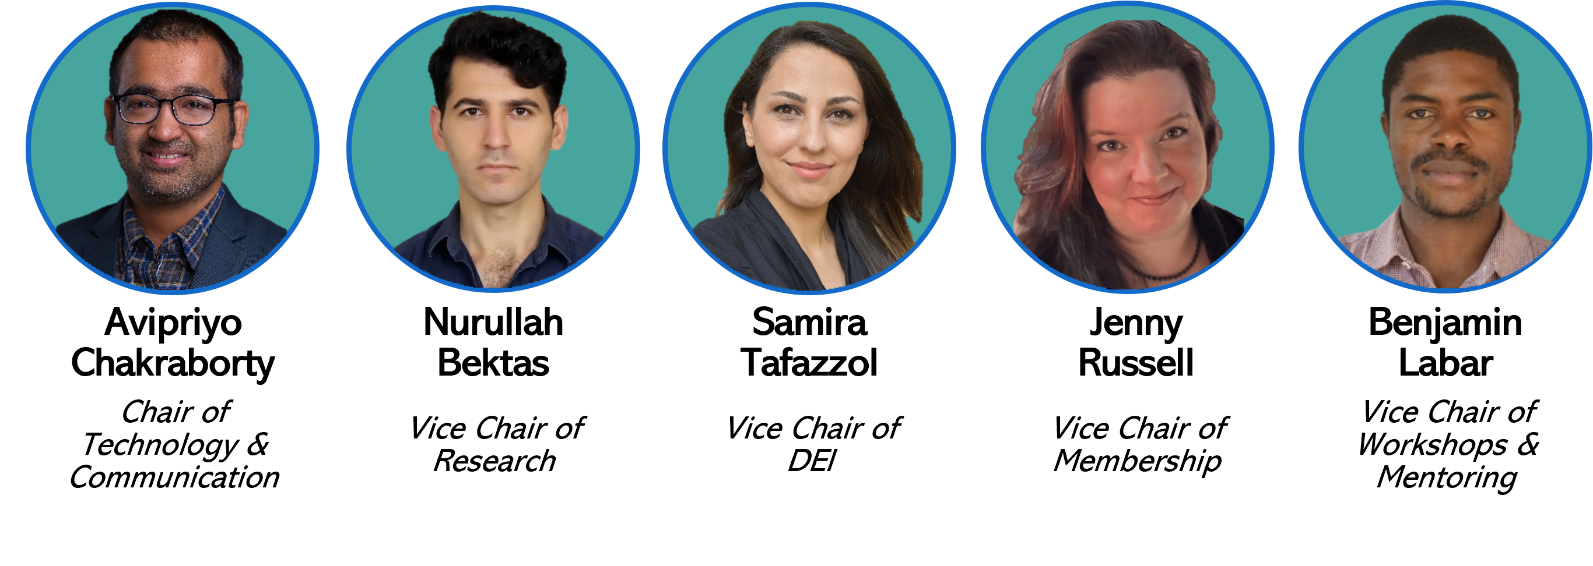
New NHERI GSC Leadership!
Notes:
https://designsafe-ci.zoom.us/meeting/register/tJwufuqqqzIvGtccud5YOr45cD5P181IQnwa

Slide 7
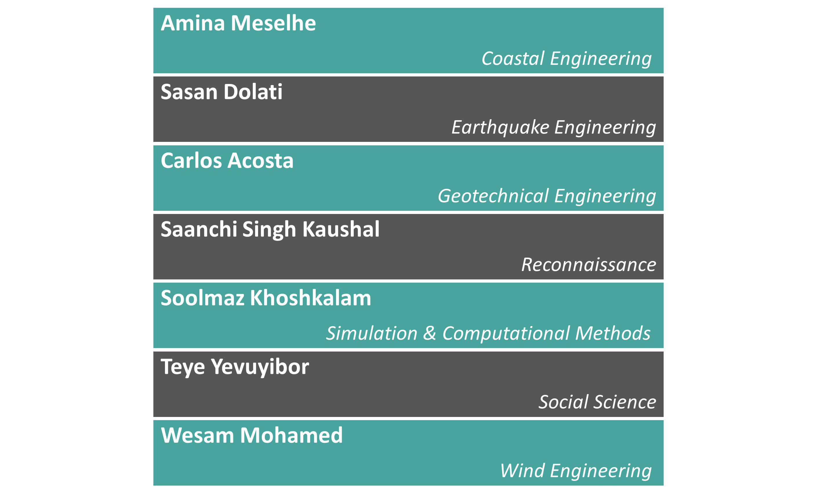
New NHERI GSC RSR!
Notes:
https://designsafe-ci.zoom.us/meeting/register/tJwufuqqqzIvGtccud5YOr45cD5P181IQnwa

Slide 8
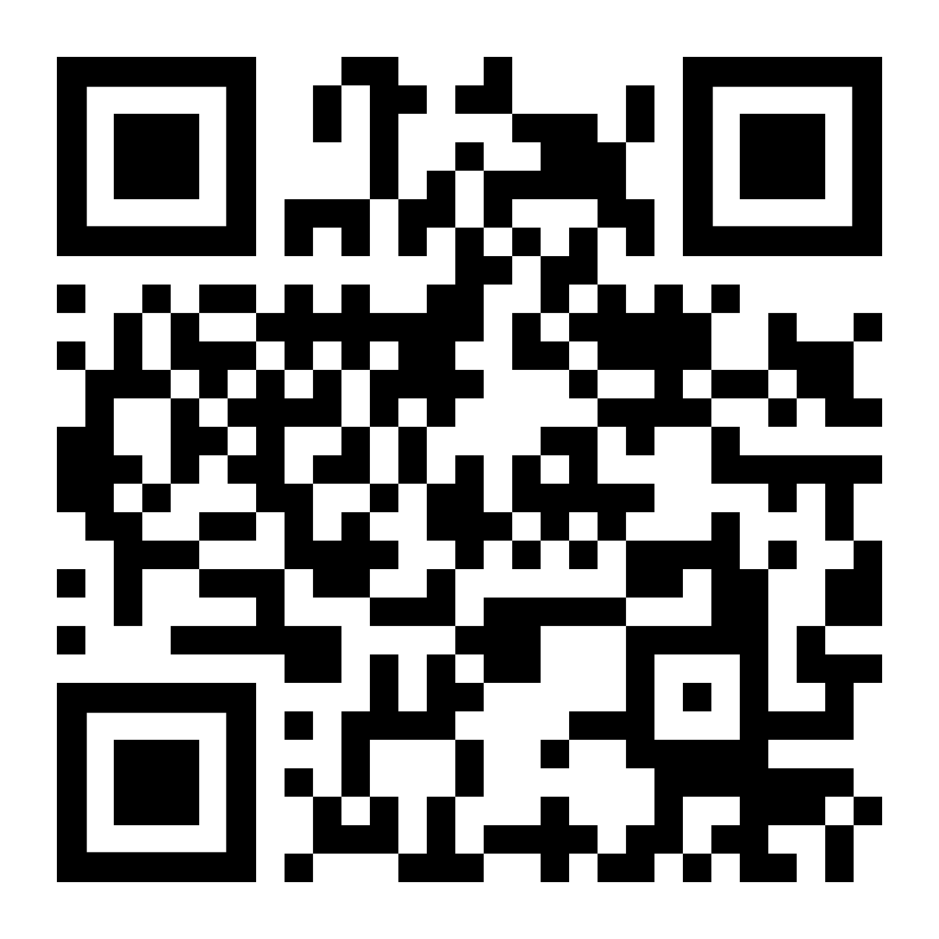
NHERI Summer Institute
The NHERI Summer Institute is a free event to learn more about the Natural Hazards Engineering Research Infrastructure (NHERI) community. During the three-day Institute participants meet with NHERI site representatives, K-12 educators, NSF CAREER Awardees, and a program director from the National Science Foundation (NSF). At least five NHERI GSC will be selected to attend. DEADLINE IS FRIDAY, FEBRUARY 25, 2024!
June
12-14
https://bit.ly/2024NHERI_SummerInstitute
Notes:
At least 5 NHERI GSC members will be select for funding to attend the NHERI Summer Institute. Members must be in good standing and have attended at least two meetings in fall 2023 or before the February 25, 2024, deadline.

Slide 9
Speaker Introduction
Dr. Tim Cockerill
Program Director at TACC and DesignSafe Deputy Project Director
cockerill@tacc.utexas.edu
Notes:
Dr. Tim Cockerill serves as the:
Program Director at the Texas Advanced Computing Center,
as the Systems Engineer for the Leadership Class Computing Facility (LCCF) project,
and as the DesignSafe Deputy Project Director.
He is also a co-PI on an NSF award supporting under-served universities.
He joined TACC in 2014, initially as Director of Center Programs and later as Director of User Services (2018-2023).
Before TACC, he worked on XSEDE and TeraGrid projects and spent a decade in startup companies focused on gallium arsenide materials and semiconductor lasers.
Dr. Cockerill holds B.S., M.S., and Ph.D. degrees from the University of Illinois at Urbana-Champaign
… and some of his publications include:
"Enhancing Research in Natural Hazards Engineering Through the DesignSafe Cyberinfrastructure" (2020),
"Chameleon: a scalable production testbed for computer science research" (2019), and
"DesignSafe: A New Cyberinfrastructure for Natural Hazards Engineering" (2017)...
... just to name a few.

Slide 10
Future Meeting Date
3rd Friday of every month at 11:00am
CST
December
15

